Slide 1
.NET
Free. Cross-platform. Open source.
A developer platform for building all your apps.
www.dot.net

Slide 2














Your platform for building anything
DESKTOP
WEB
CLOUD
MOBILE
GAMING
IoT
AI
.NET
Notes:
You can build anything with .NET. From desktop apps to cloud-native services, iPhone and Android mobile apps to artificial intelligence, you can build almost anything with the .NET platform.

Slide 3














.NET is a software development platform
TOOLS
DESKTOP
WEB
CLOUD
MOBILE
GAMING
IoT
AI
VISUAL STUDIO
.NET STANDARD
VISUAL STUDIO FOR MAC
LIBRARIES
VISUAL STUDIO CODE
INFRASTRUCTURE
RUNTIME COMPONENTS
COMPILERS
LANGUAGES
COMMAND LINE INTERFACE
Notes:
.NET is an entire software development platform that takes care of a lot of the heavy lifting for you when you want to build an application. Applications frameworks help you build the specific types of apps or workloads and enable you to literally build any app for any platform with any operating system. Each .NET workload shares a common infrastructure and .NET Standard library. This means not only are your .NET skills portable, but your actual code is portable no matter what you’re building. This makes it easy to share reusable components (called libraries) across the breadth of applications people build.
Additionally, there are a broad set of development tools that makes it really productive to write, debug, build and manage code bases.
See: www.dot.net

Slide 4
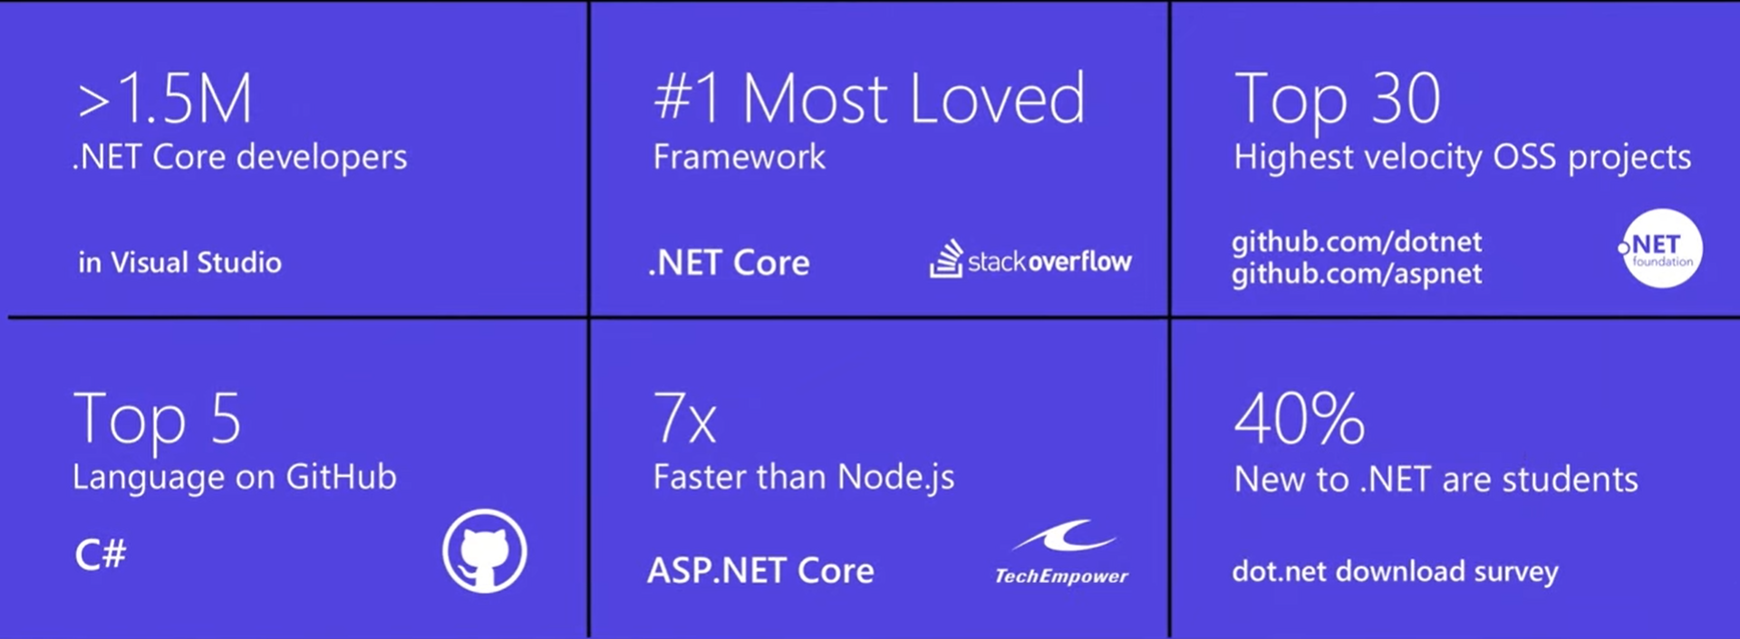
.NET ecosystem momentum

Slide 5
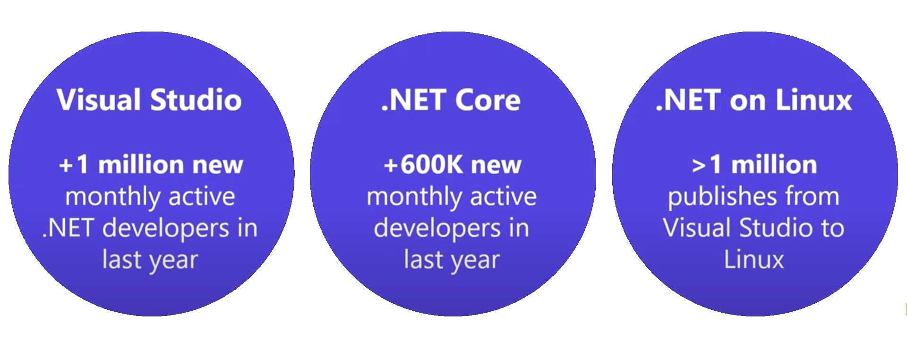
Adoption
Visual Studio
+1 million new monthly active .NET developers in last year

Slide 6
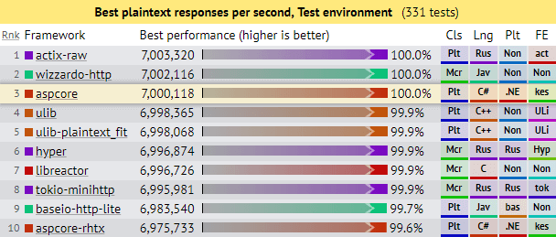
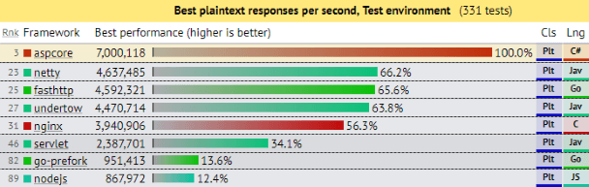
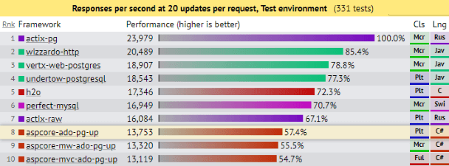
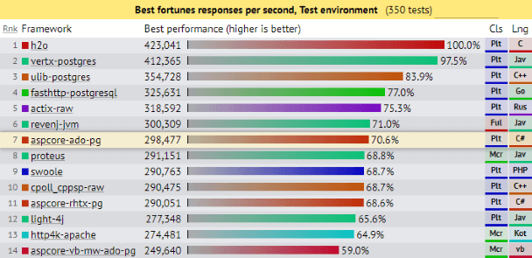
.NET is Fast. Really Fast!
Notes:
.NET is fast. Really fast! That means applications provide better response times and require less compute power. StackOverflow serves 5.3M page views a day on just 9 servers!
The popular TechEmpower benchmark compares web application frameworks with tasks like JSON serialization, database access, and server side template rendering - .NET performs faster than any other popular framework.
https://www.techempower.com/benchmarks/
The community has played a crucial role in performance work for the .NET stack.
https://blogs.msdn.microsoft.com/dotnet/tag/performance/
https://www.ageofascent.com/2019/02/04/asp-net-core-saturating-10gbe-at-7-million-requests-per-second/

Slide 7
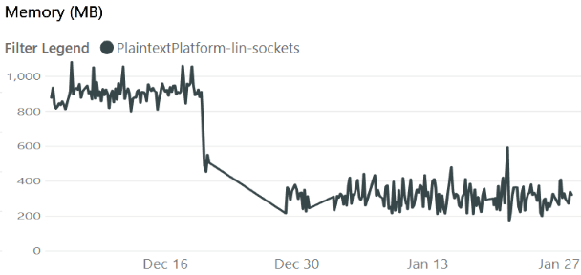
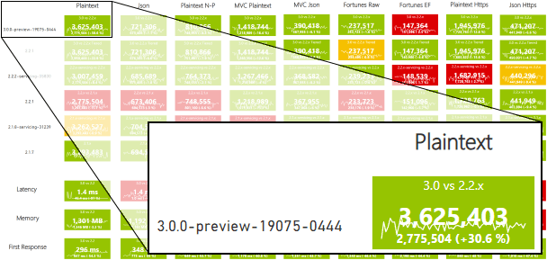
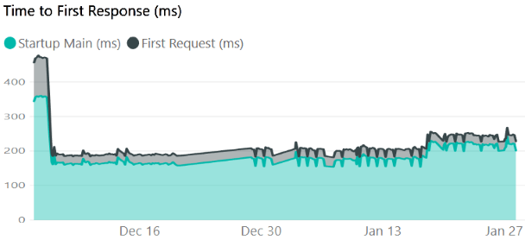

… and is getting even faster
https://aka.ms/aspnet/benchmarks
6 minutes, 64 connections, 120.000.000 requests
Notes:
.NET is fast. Really fast! That means applications provide better response times and require less compute power. StackOverflow serves 5.3M page views a day on just 9 servers!
The popular TechEmpower benchmark compares web application frameworks with tasks like JSON serialization, database access, and server side template rendering - .NET performs faster than any other popular framework.
https://www.techempower.com/benchmarks/#section=data-r14&hw=ph&test=plaintext
The community has played a crucial role in performance work for the .NET stack.
https://blogs.msdn.microsoft.com/dotnet/tag/performance/

Slide 8


.NET is Open Source
Community Accepted PRs
“Samsung is embracing .NET because it is a completely open source project.” — Samsung
".NET is open source; that allows us to contribute back to it if we have any performance issues which Microsoft review and together we make a better product.“ — Illyriad Games
16,000+ Community Contributions from 3000+ Companies outside Microsoft
Notes:
We’ve seen companies taking a bet on .NET because it’s a completely open source project. More than 16,000 contributors* from 3300 companies have contributed to .NET Core and related open source repositories, with over half of the contributions coming from outside Microsoft.
Samsung is a big partner and are releasing their new Smart TVs that support .NET. They plan to expand to all their IoT devices too. Illyriad Games, specifically Ben Adams, contributed many performance enhancements to the platform. They build a MMO with hundreds of thousands of concurrent users so performance is super important to them. These enhancements not only benefit them but everyone that uses .NET.
*contributor = Submitted a Pull Request or Created an Issue

Slide 9


.NET Open Source Journey
2001- ECMA-335
2002- .NET 1.0 for Windows released, Mono project begins
April 2014- .NET Compiler Platform (“Roslyn”) Open Source .NET Foundation founded
Nov 2014- .NET Core Cross-plat, Open Source
2008- ASP.NET MVC (web platform) Open Source
.NET
Aug 2017- .NET Core 2
2016- Mono project joins .NET Foundation
Notes:
This didn’t happen overnight. Here’s a little history of .NET open source…..
Dec 2001-Feb 2002.
A new platform is born. Along with HP, Intel and others, the ECMA-335 standard was created that defined a common language infrastructure to support multiple programming languages. C# and Visual Basic.NET were released and F# came later in 2007, but there are over 20 other .NET languages today. Visual Studio .NET was released and included C#, VB, C++ development all in one box. This was the first IDE that was truly integrated across multiple languages.
Mono project begins. The CLI spec gave others the ability to create their own .NET implementations. Even though Microsoft built the first .NET Framework for Windows-only, the spec was intentionally portable across OSes and chipsets. The Mono project began, spearheaded by Miguel de Icaza, with the goal to implement Microsoft's new .NET development platform on Linux and Unix-like platforms. Later, Miguel started Xamarin which focused on cross-platform, native, mobile development with C#, built upon Mono. This allows developers to use C# and .NET to build apps for iOS and Android. Unity games development also emerged from Mono.
2008.
ASP.NET MVC web development stack is released to CodePlex as open source. This was the first application development framework from Microsoft to be released as open source. The underlying runtime and compilers were still closed however.
2014.
Hell freezes over & pigs fly. Early 2014 at Microsoft’s BUILD conference, Anders Hejlsberg, the father of C#, releases the .NET Compiler Platform “Roslyn” as open source on stage. Later in November, .NET Core project begins in the open. The technology world is shocked, and the .NET community is excited. .NET Core is a new cloud-native implementation of .NET that is geared for cross-platform, hyper-scale services as well as small IoT devices. It’s meant to bring .NET into the next 15 years of computing. And the community has been extremely supportive.
2016.
Mono comes home. In early 2016, Microsoft finally acquires Xamarin and brings Miguel de Icaza into Developer Division. Mono joins the .NET foundation and is officially supported and contributed to by Microsoft. The Microsoft community officially meets the Mono community.
2017.
.NET Core 2.0 Released. Our cross platform and open source implementation of .NET finally releases to the world with unified tooling support across multiple operating systems and editors.

Slide 10


Make it easier with some free tools www.VisualStudio.com
Visual Studio
A fully-featured, integrated development environment (IDE) for developing .NET apps on a Windows PC development machine.
Visual Studio Code
Open source, cross-platform editor with .NET support.
Visual Studio for Mac
A fully-featured IDE for developing .NET apps on a Mac OS development machine.
Download from www.VisualStudio.com
Notes:
We also have free tools that can help you build your apps.

Slide 11
Future

Slide 12
The .NET Roadmap
Many
.NETs
2014
.NET FRAMEWORK
.NET CORE
XAMARIN / MONO
Runtime
Runtime
Runtime
Base class library
Core library
Mono class library

Slide 13
The .NET Roadmap
Many
.NETs
.NET
standard
2014
2016
.NET FRAMEWORK
.NET CORE
XAMARIN / MONO
Runtime
Runtime
Runtime
Base class library
Core library
Mono class library
.NET STANDARD

Slide 14
The .NET Roadmap
Many
.NETs
.NET
standard
.NET
2014
2016
Next
.NET FRAMEWORK
.NET CORE
.NET
XAMARIN / MONO
Runtime
Runtime
Runtime (JIT & native)
Runtime
Core library
Base class library
One base class library
Mono class library
.NET STANDARD
Notes:
Mono merguje sie do .net core (juz jest)
A .net framework wymiera

Slide 15
.NET 5 to .NET 6 “wave”
Supports all .NET application types
Evolution of .NET Core, adding the best of Mono into one unified platform
One BCL implementation, still adheres to .NET Standard
One toolchain (SDK style projects)
Both Just-in-Time (JIT) and native models supported
Interop with Java and Swift

Slide 16
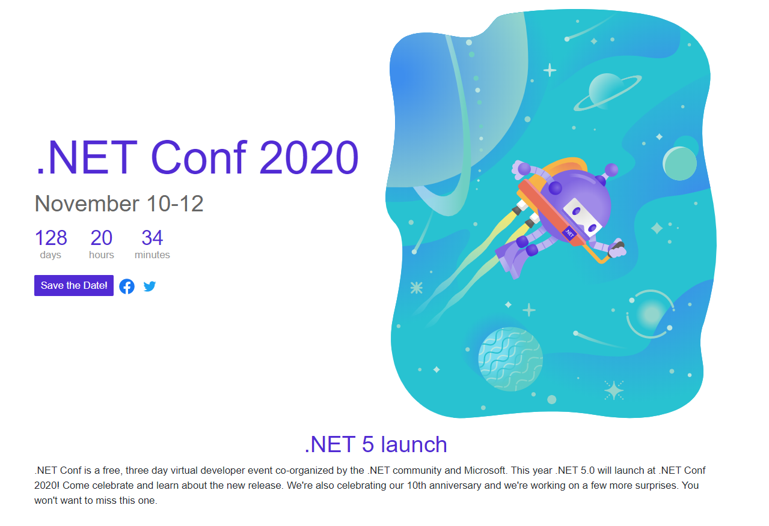

Slide 17
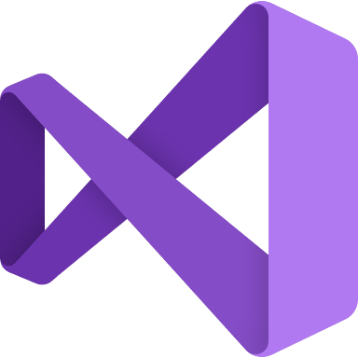


.NET - a unified platform
TOOLS
DESKTOP
WEB
CLOUD
MOBILE
GAMING
IoT
AI
WPF
Windows forms
UWP
ASP.NET
Azure
Xamarin
Unity
ARM32
ARM64
ML.NET
.NET for Apache Spark
VISUAL STUDIO
.NET STANDARD
VISUAL STUDIO FOR MAC
.NET 5
VISUAL STUDIO CODE
INFRASTRUCTURE
RUNTIME COMPONENTS
COMPILERS
LANGUAGES
COMMAND LINE INTERFACE

Slide 18
.NET Schedule
July 2019
.NET Core 3.0
RC
Sept 2019
.NET Core 3.0
Nov 2019
.NET Core 3.1
LTS
Nov 2020
.NET 5.0
Nov 2021
.NET 6.0
LTS
Nov 2022
.NET 7.0
Nov 2023
.NET 8.0
LTS
.NET Core 3.1 = Long term support (LTS)
.NET 5.0 release in November 2020
Major releases every year, LTS for even numbered releases
Predictable schedule, minor releases if needed

Slide 19
Cloud native investments
Faster cross-platform development with WSL
Smaller microservices, single file EXE, top-level C# programs (C# 9.0)
Opinioneted .NET microservices & orchestration tool “Project Tye”
High-performance reverse proxy “Project YARP”

Slide 20
Learn more

Slide 21
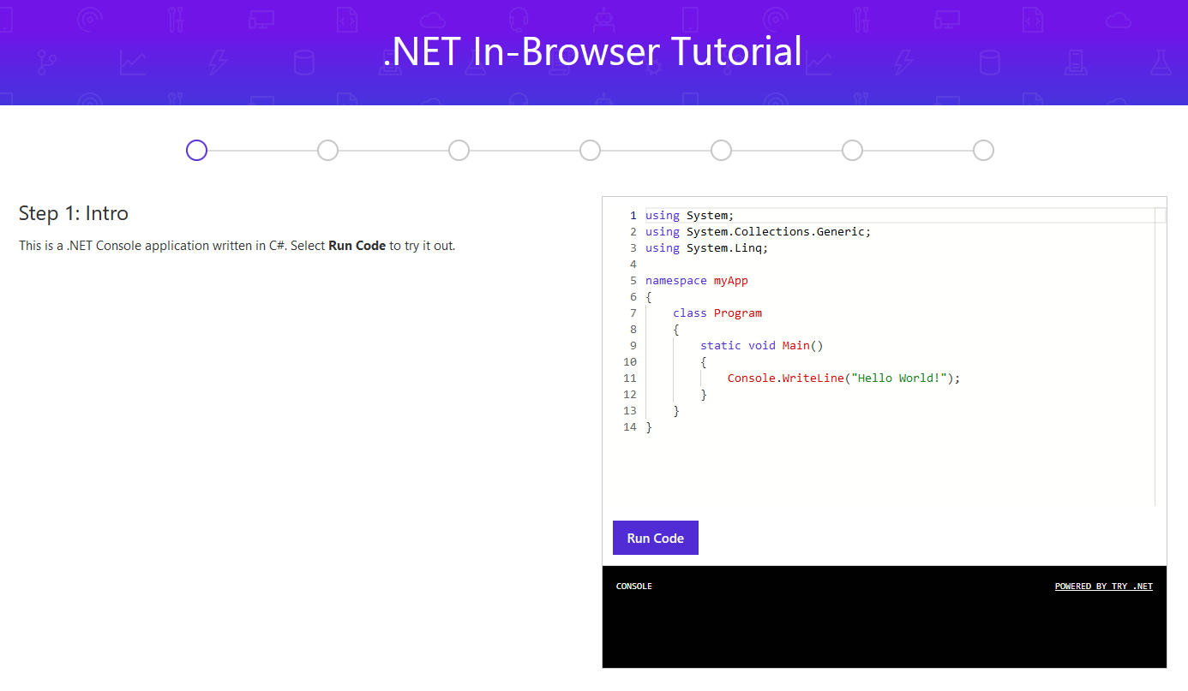
Learn how to program with C#
try.dot.net
Notes:
So you want to learn .NET? Start with a language. We make it easy to get started learning right in your browser.

Slide 22
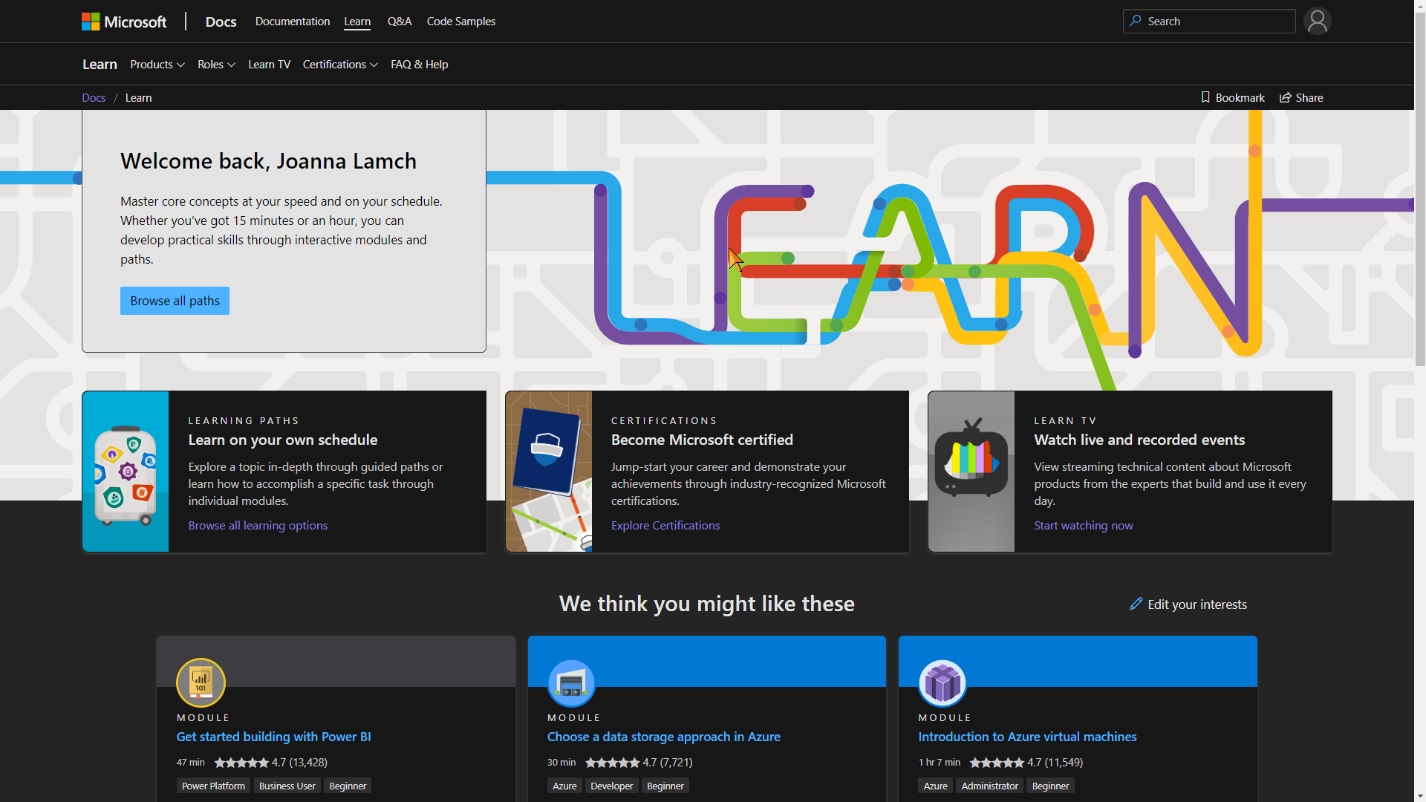
Learn? Microsoft Learn
https://docs.microsoft.com/en-us/learn/

Slide 23
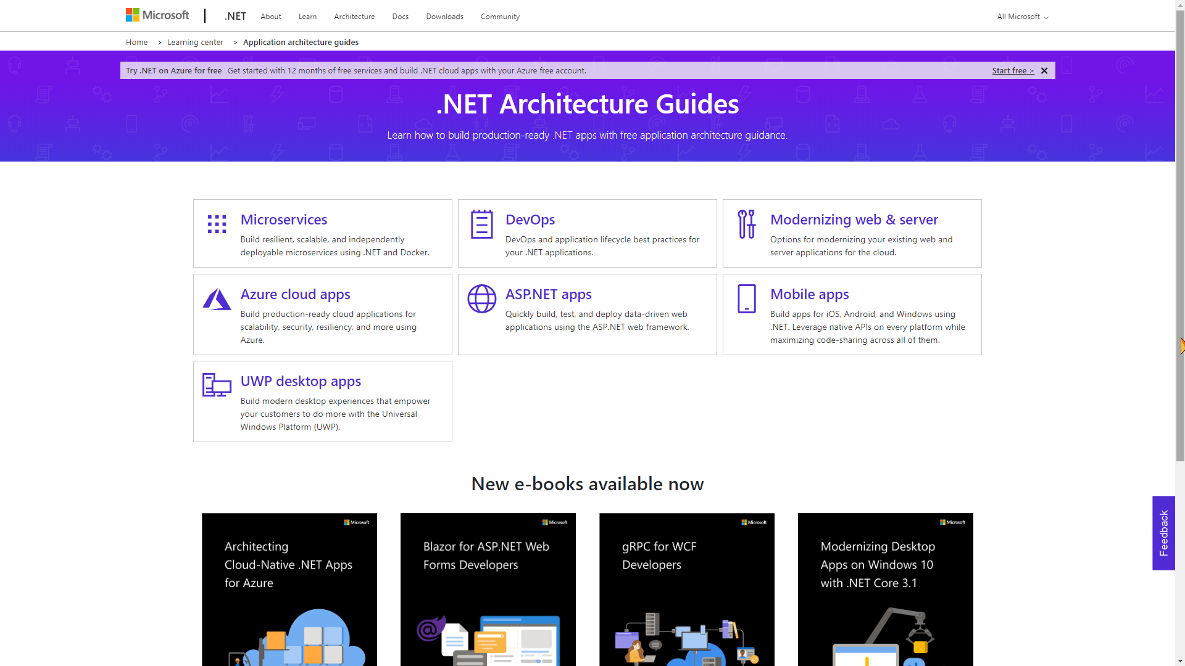
https://github.com/dotnet-architecture
https://dotnet.microsoft.com/learn/dotnet/architecture-guides
Notes:
https://github.com/dotnet-architecture
https://dotnet.microsoft.com/learn/dotnet/architecture-guides

Slide 24
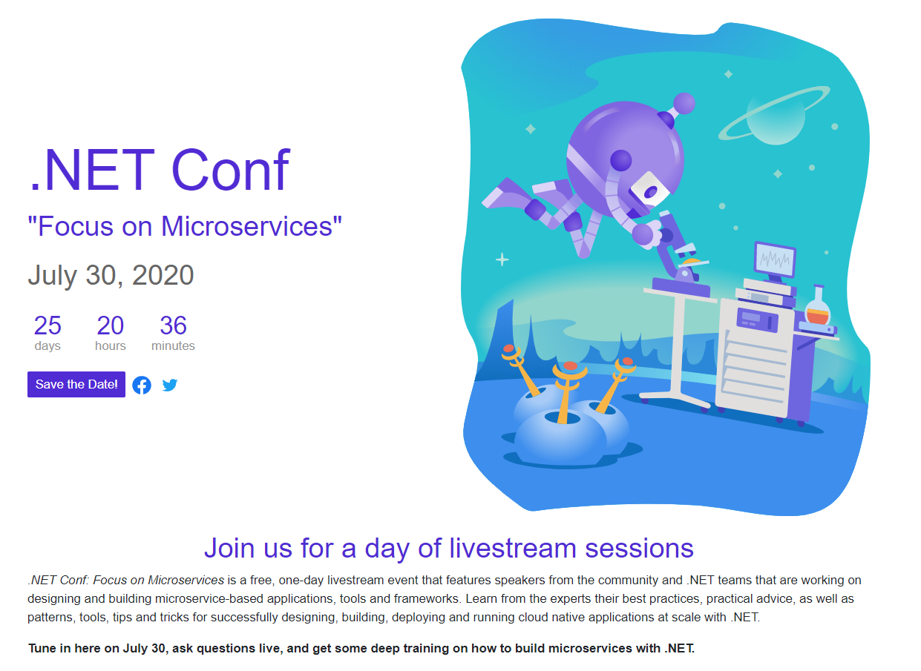

Slide 25
Thanks! Questions?

